Slide 1
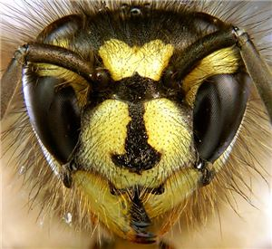
The WEE Beasties

Slide 2
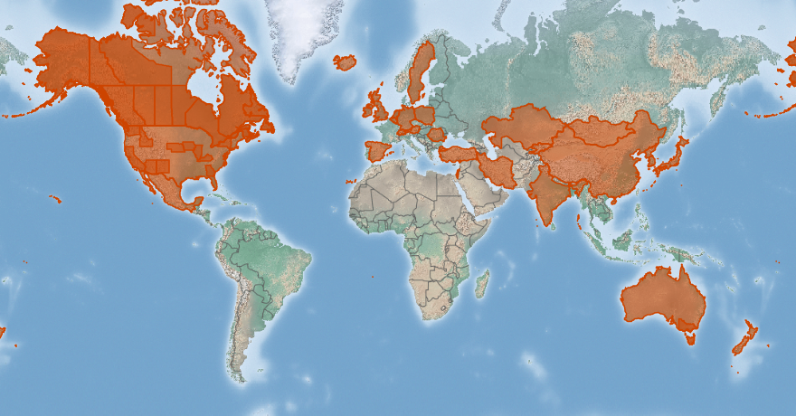
Location of Wasp throughout the world

Slide 3
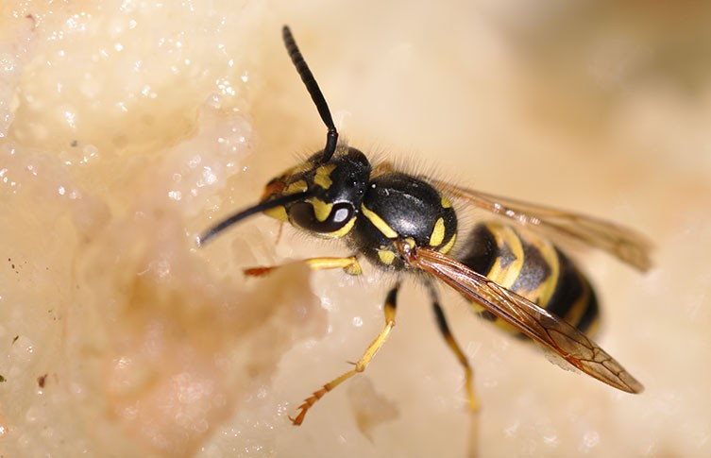
Notes:
The common wasp or German Wasp

Slide 4
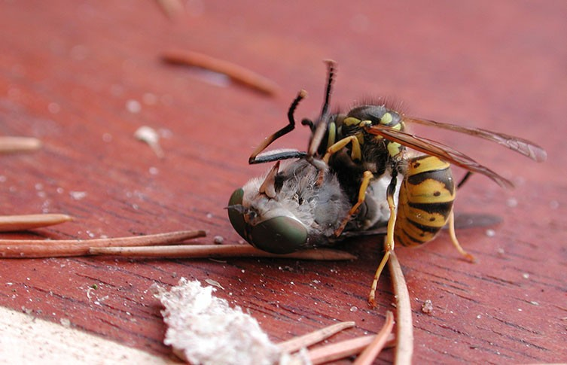
Notes:
A Horse Fly succumbs as victim to the wasp

Slide 5
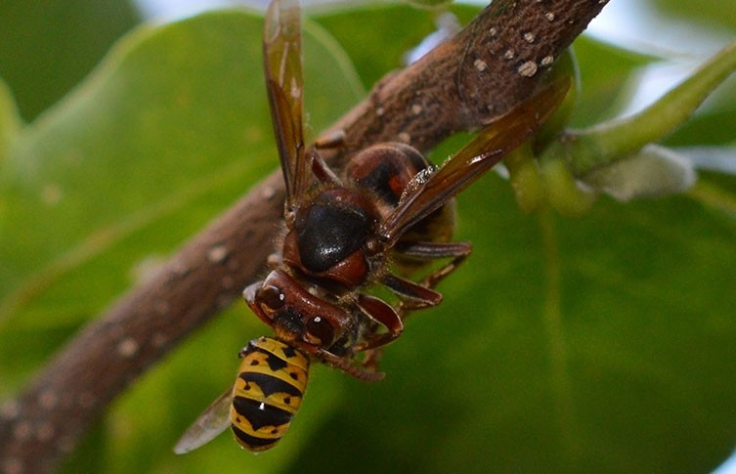
Notes:
Wasps may become a food source for other insect, Here a European Hornet has captured a common wasp.

Slide 6
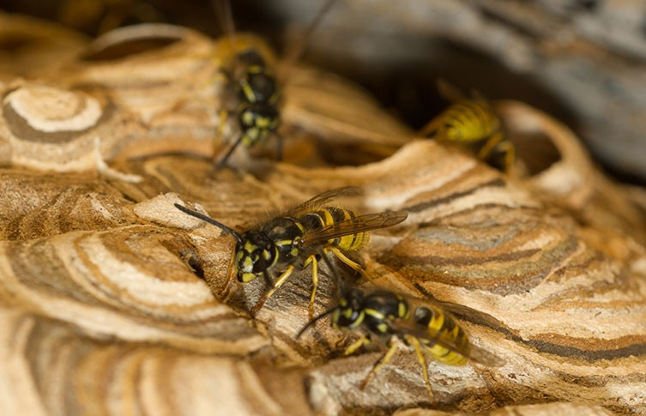
Notes:
Wasps on the exterior of their paper nest (wood pulp)

Slide 7
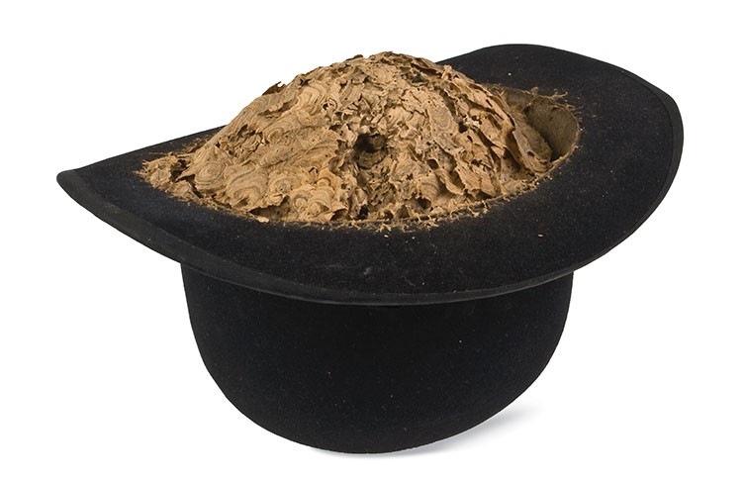
Notes:
They will utilise any item they find to make their nest(home) in

Slide 8
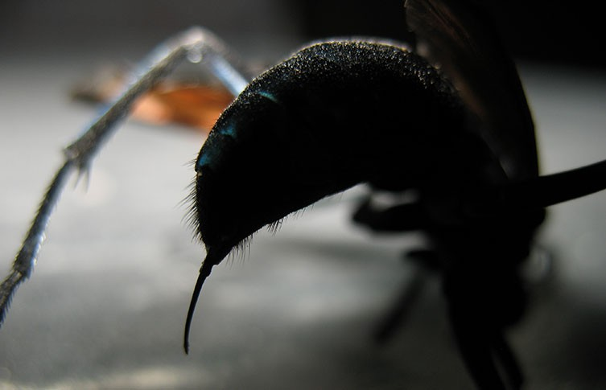
Notes:
The smooth sting of the Tarantular Hawk (genus pepsis).

Slide 9
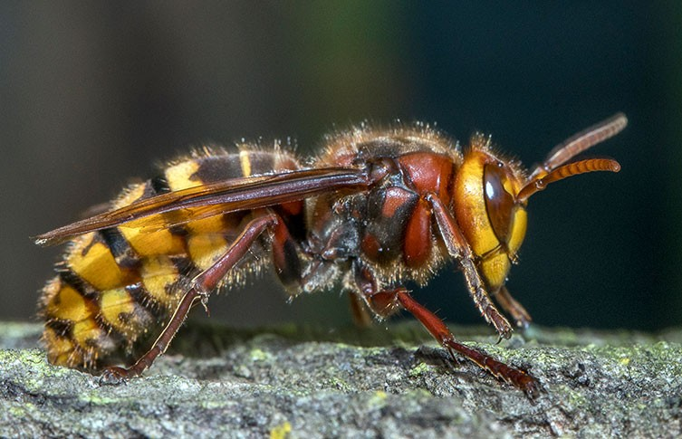
Notes:
The European Hornet (Vespa Crabro) shares similar colouration and pattern similar to other social wasps.

Slide 10
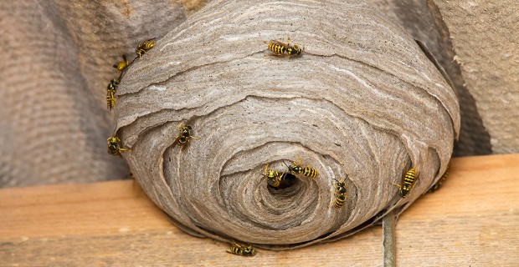
Notes:
Wasps are constantly maintaining their nest, if it get too hot inside they will form a chain to move air with their wings to cool the nest.

Slide 11
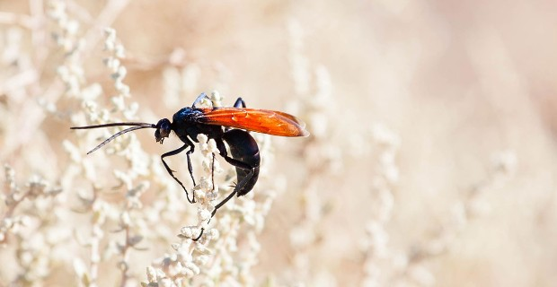
Notes:
Tarantula Hawks wasps have the most painful sting in the wasp world..

